Slide 1
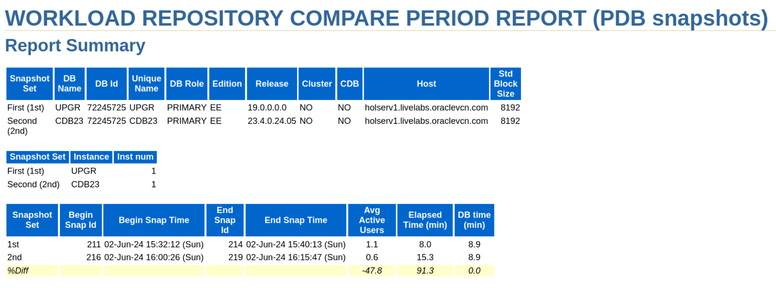
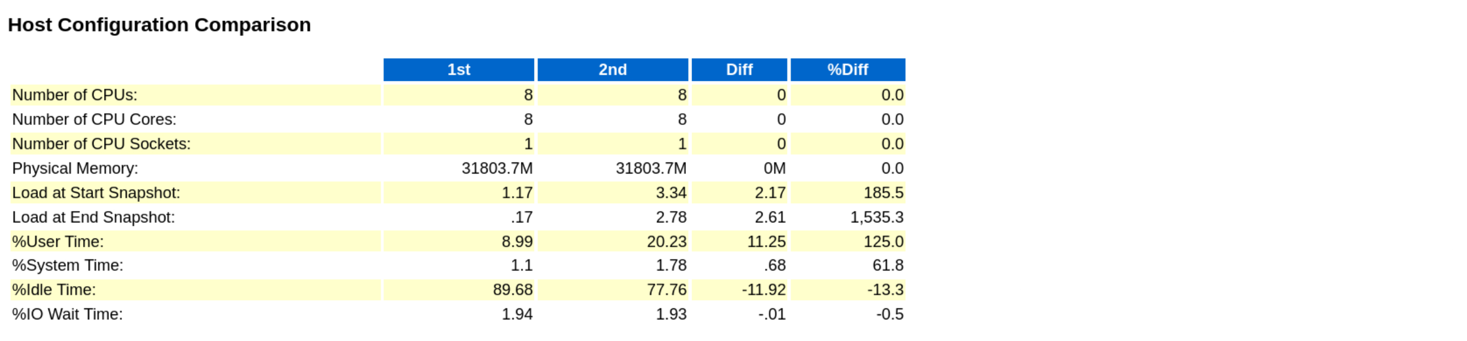

Slide 2
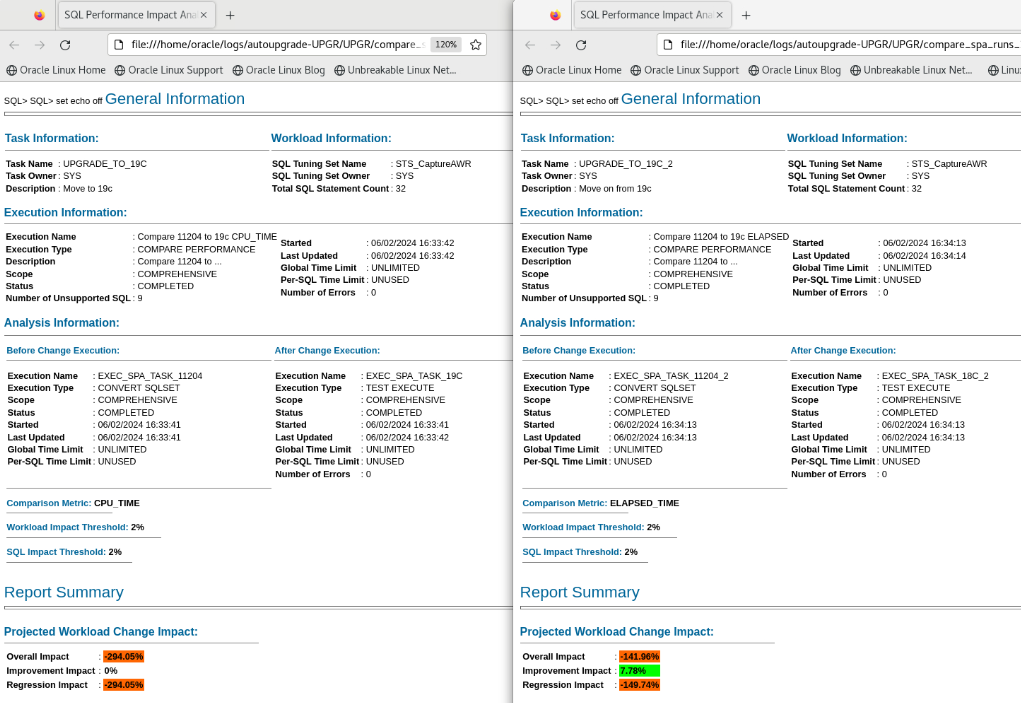

Slide 3
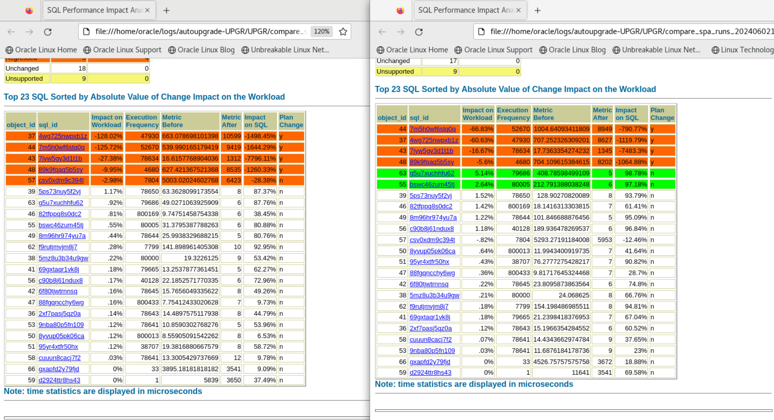

Slide 4
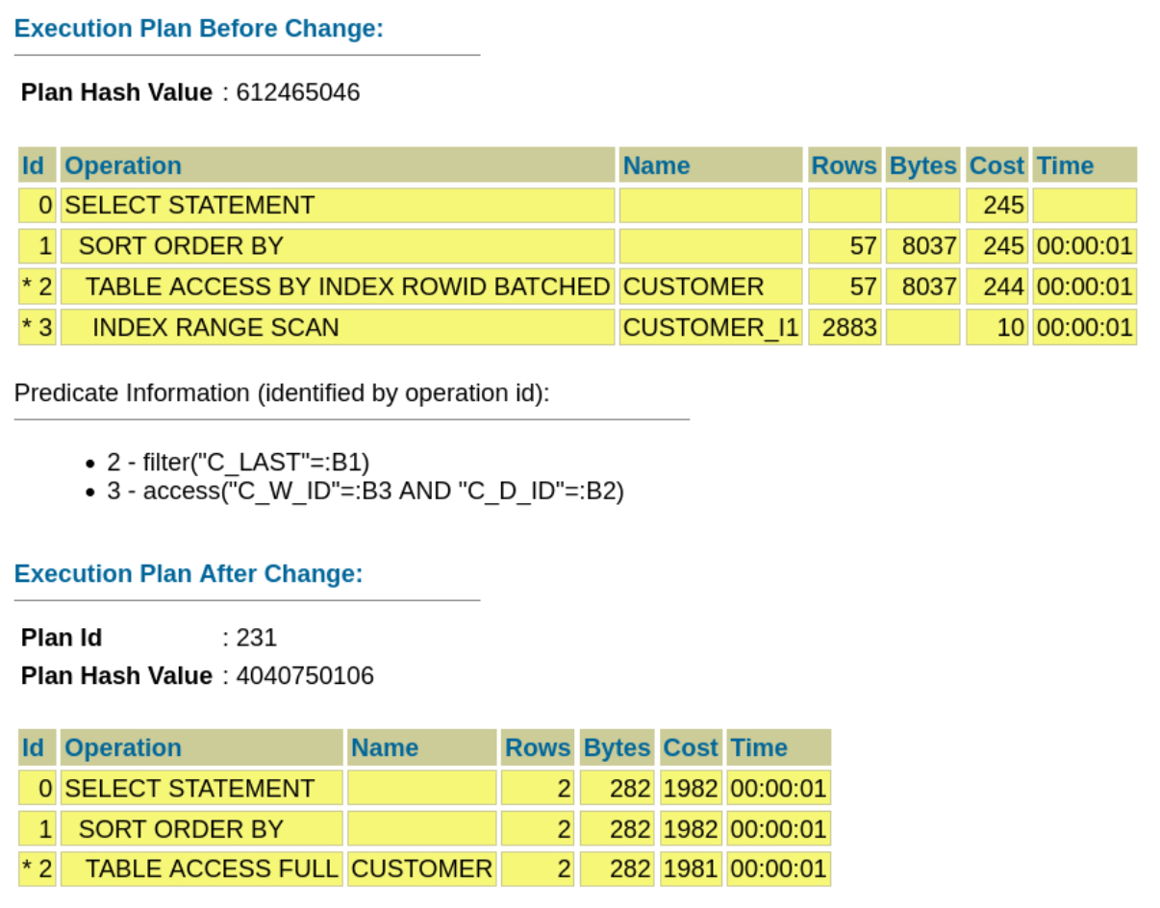

Slide 5
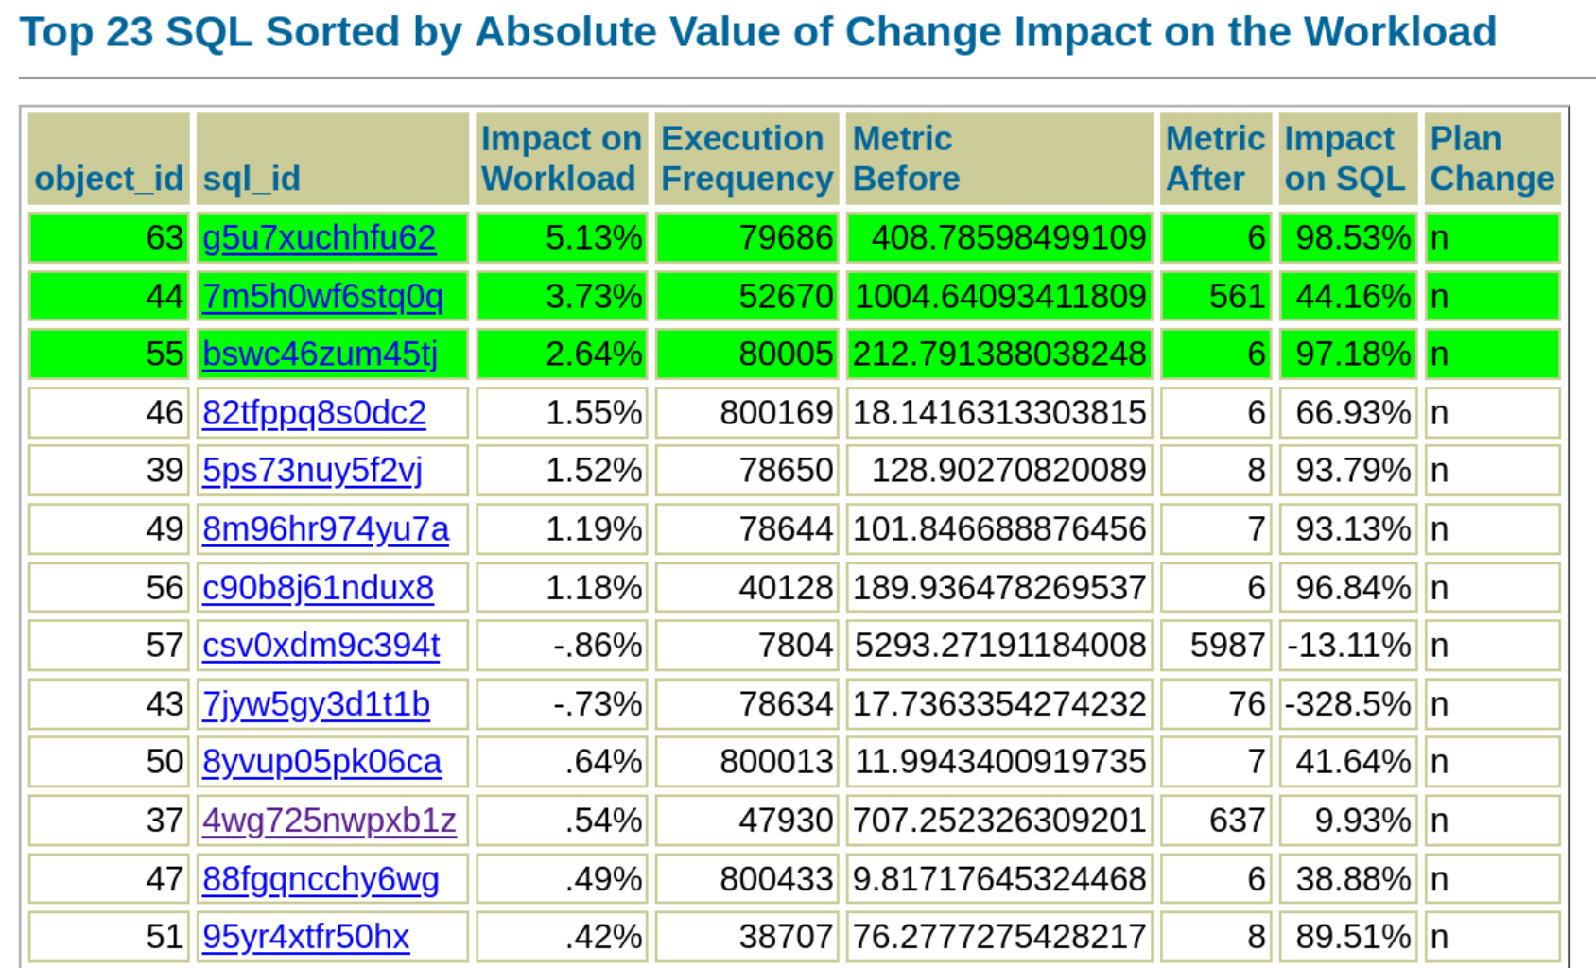

Slide 6
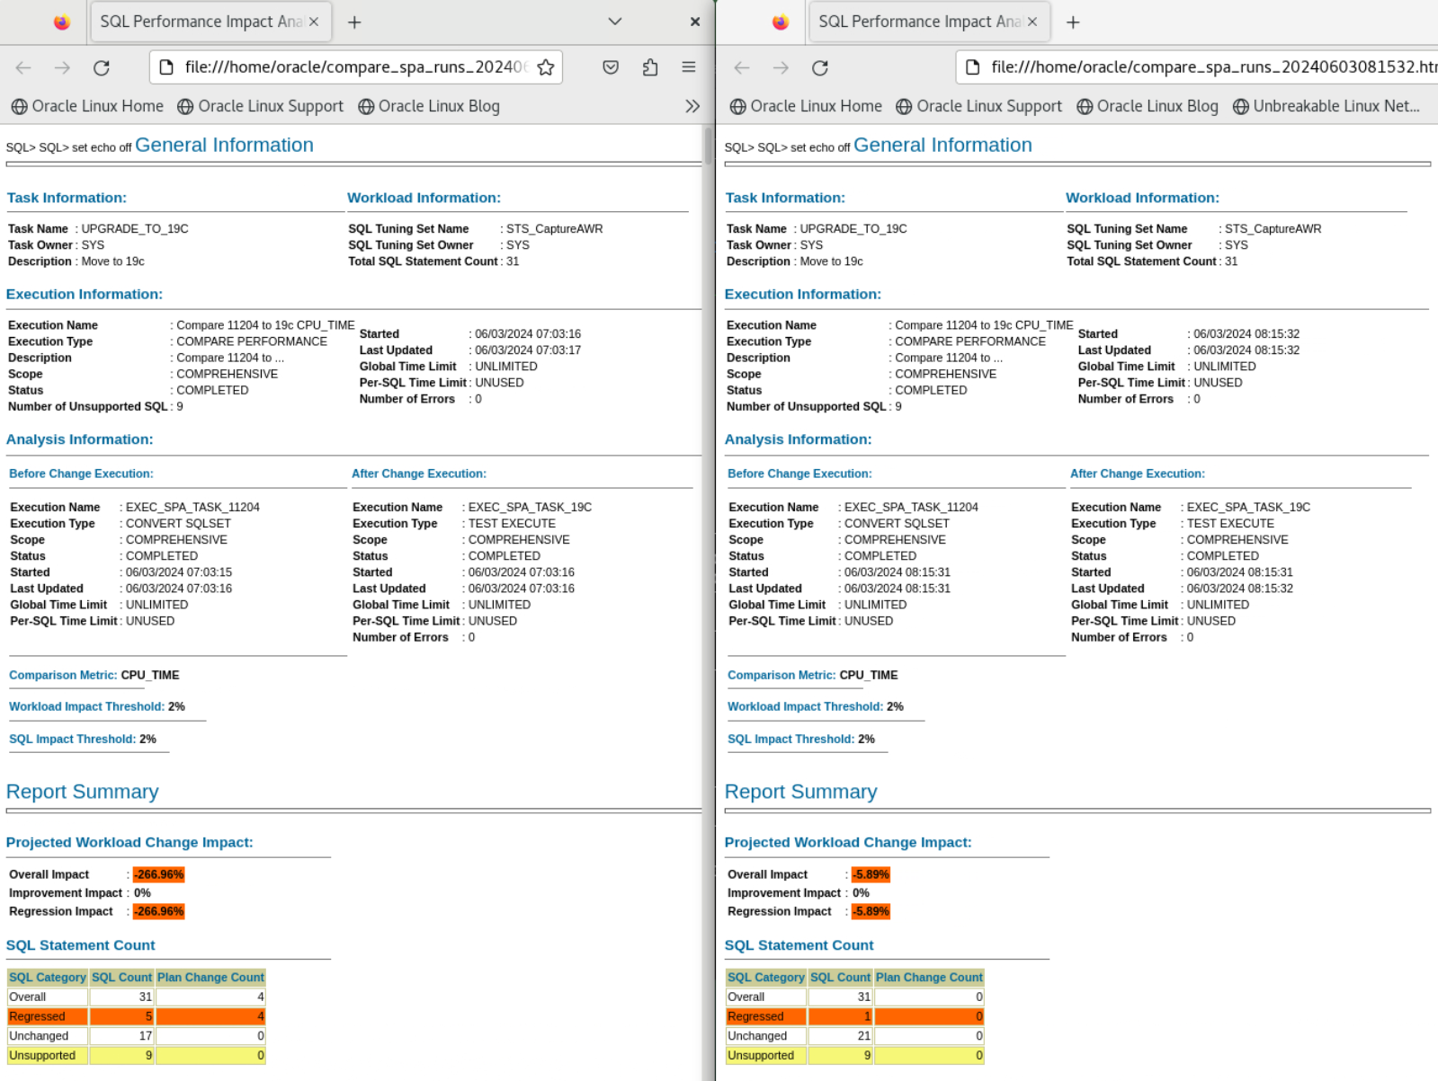

Slide 7
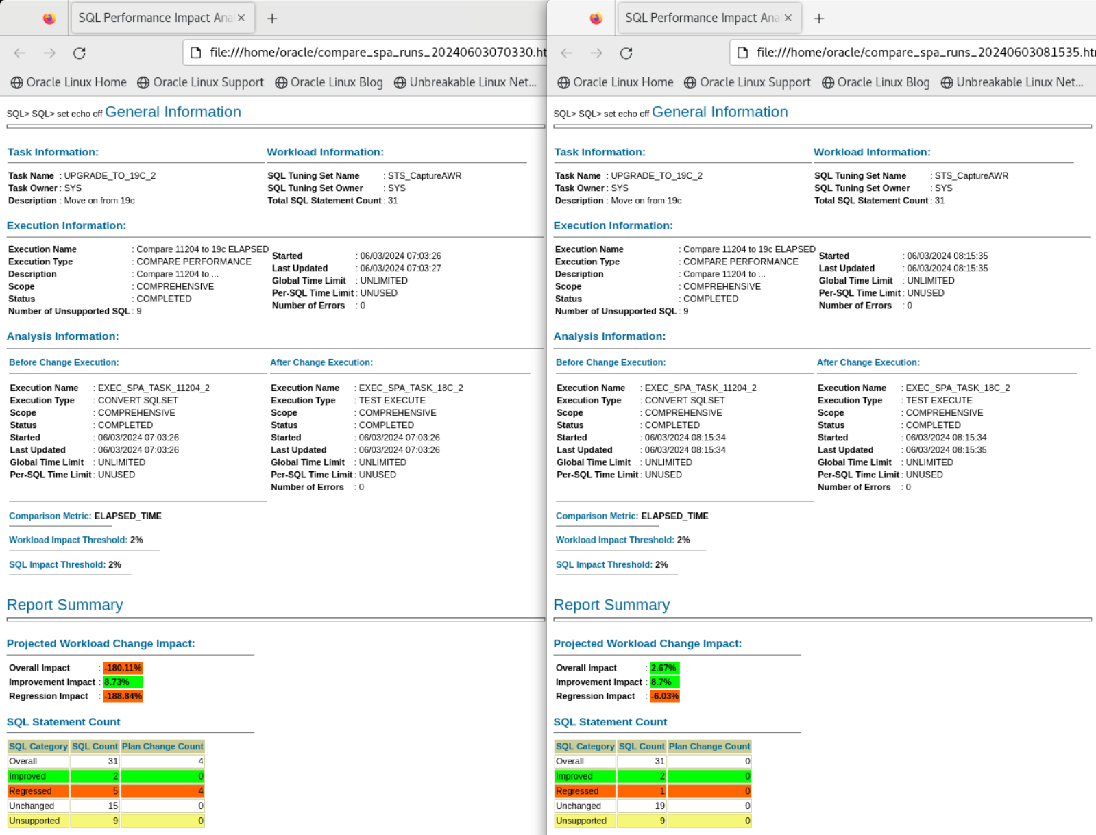

Slide 8
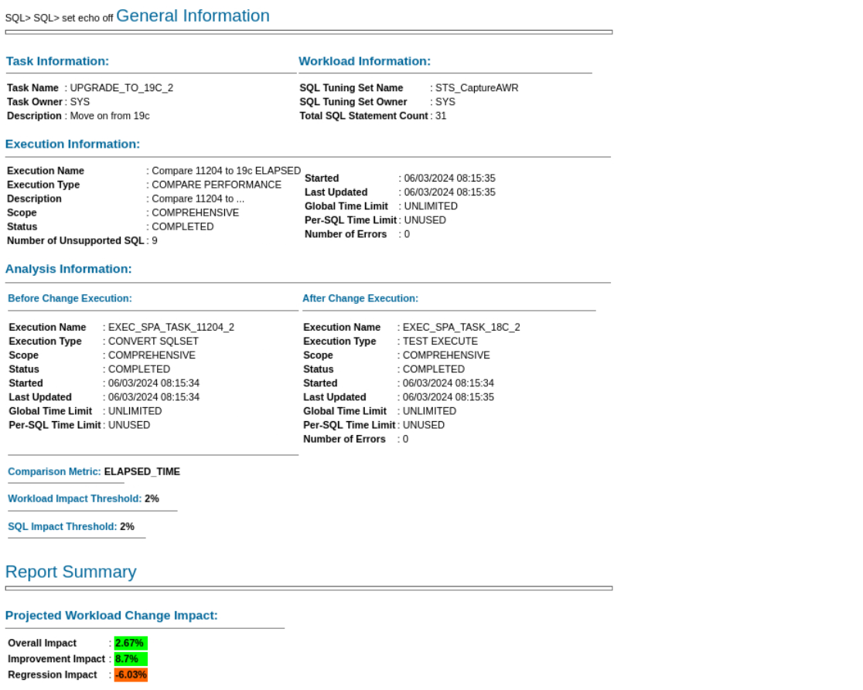

Slide 9



 | Database | PDBs | Set environment
Oracle Database 19c /u01/app/oracle/product/19
Oracle Database 21c /u01/app/oracle/product/21
Oracle Database 23ai /u01/app/oracle/product/23
UPGR
. upgr
FTEX
. ftex
CDB19
ORANGE
. cdb19
CDB23
RED, BLUE, GREEN
. cdb23
CDB23COM
ORANGE
. cdb23com

Slide 10
Labs
1 | 2 | Track 1 | 2 | 4 | 5 | 6 | 7 | 8 | 9 | 14
 |  | Track 2 | 10 | 15
 |  | Track 3 | 11 | 12 | 13

